Slide 1

Basic Details of the Team and Problem Statement
Problem Statement Title: Fake Social Media Profile detection and reporting Team Name: VR Surgix Team Leader Name: Jasmine Singh Institute Name: Chitkara University
Theme Name: Blockchain & Cybersecurity

Slide 2
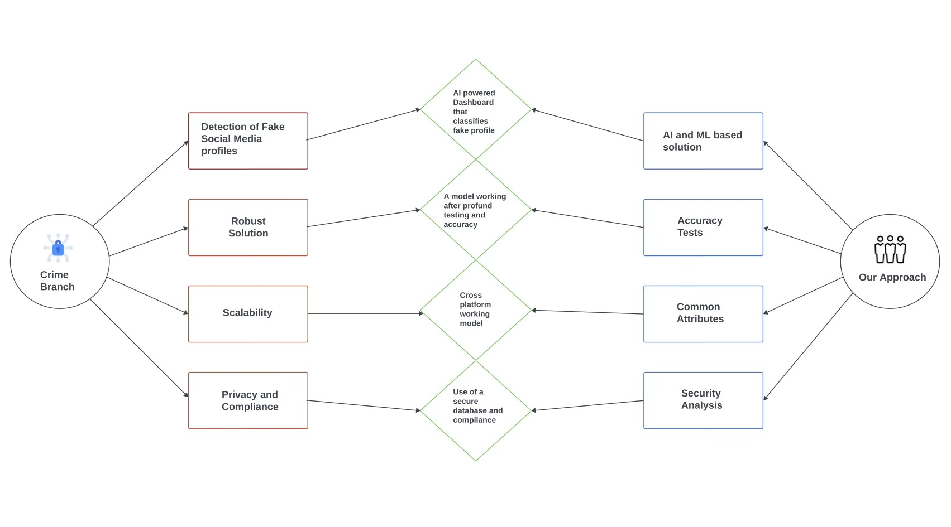

Idea/Approach Details
Idea
We seek to create a tool to empower crime branches and investigators in unearthing fake profile.
Robust identification and reporting mechanisms.
Intuitive graphical analysis dashboard.
Prioritise User Authentication and ensures security of data.
Assign risk scores based on analysis and automatically triggers alerts.
Constantly adapts detection method to outmost evolving digital threats.
Empowering our tool with cutting-edge ML and Deep Learning.
Tech Stack

Slide 3
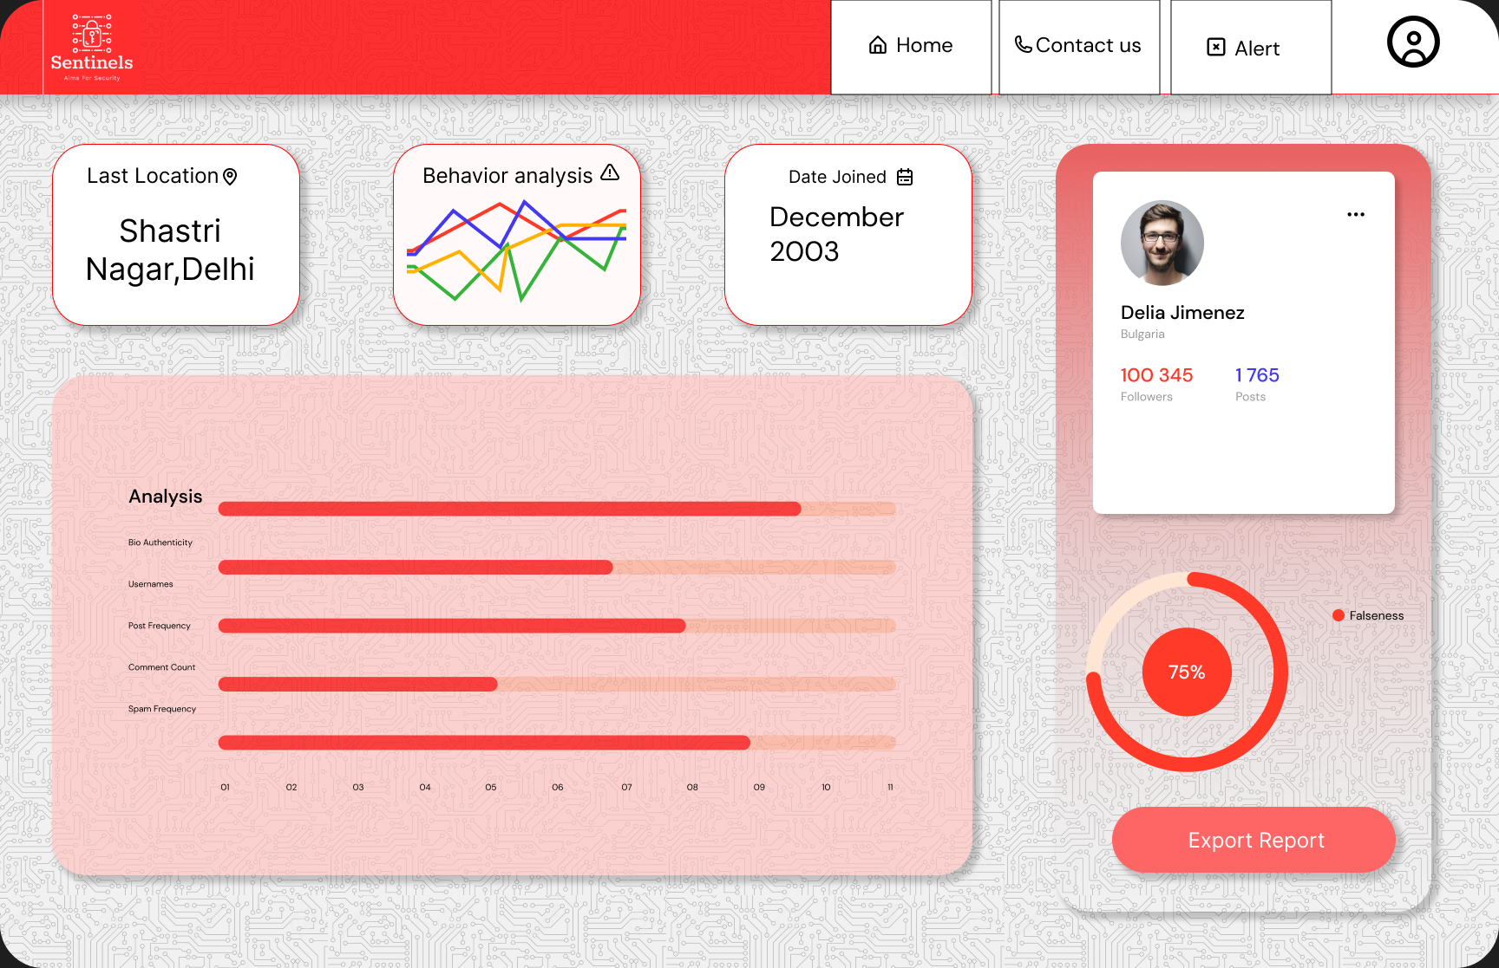
Idea/Approach Details
Show-Stopper
Use Cases
Implement Strict Access Controls: For authorized law enforcement personnel.
Comprehensive Data collection: Profiles, Posts, Tags, Comments etc.
Extracts Vital Data: Elements timestamps, profile, details, crucial for driving subsequent analysis.
Sophisticated Algorithms: ML and Deep learning models detect pattern in suspicious profile.
Scoring System: Profile receive a likelihood score those exceeding the threshold are marked suspicious.
Reporting and Action: Findings and evidence are documented in reports for legal action.
Business Model: Paid subscription plan, granting general users the access to the features for enhanced experience.
Dynamic Dashboard: Graphical, percentage based authenticity analysis of social media platforms.
Scalability and Performance: Scales effortlessly to handle high-profile volumes with resource adaptability

Slide 4
Team Member Details
Team Leader Name: Jasmine Singh
Branch: BE Stream: CSE Year: II
Team Member 1 Name: Kanushi Gupta
Branch: BE Stream: CSE Year: II
Team Member 2 Name: Aman Sharma
Branch: BE Stream: CSE Year: II
Team Member 3 Name: Aishwary Chauhan
Branch: BE Stream: CSE Year: II

